Slide 1
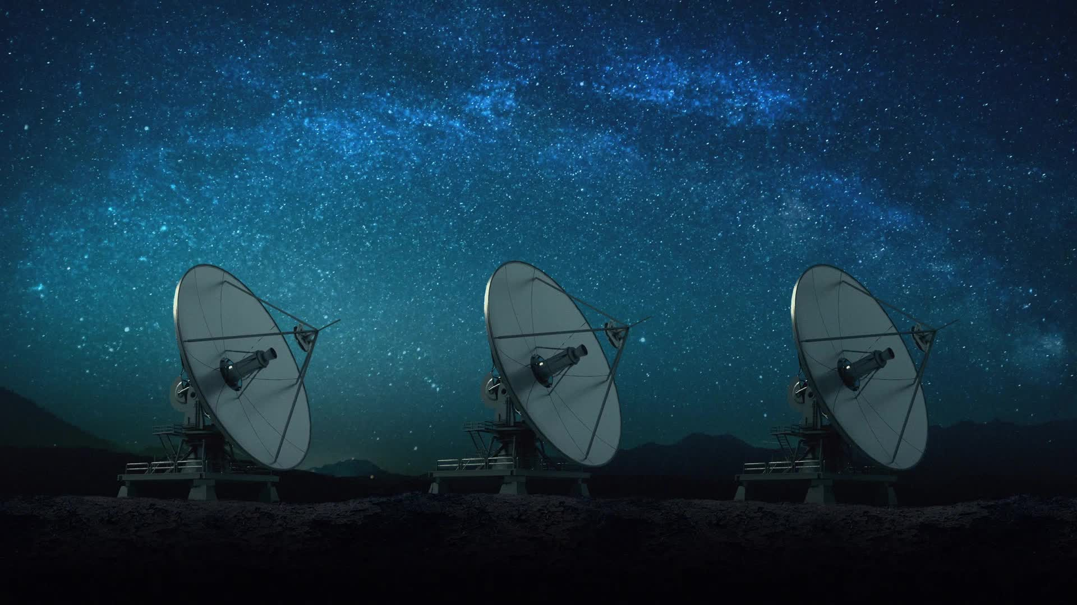
Hunting for Exoplanets with AI
By Robert Shanahan, Adam Downes, Sean Sibindi, Conor Power and Philip Roche

Slide 2
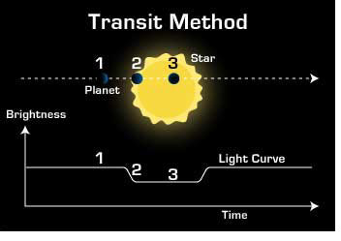
Why?
Kepler detects planets > ~1.2 Earth radii (Humphrey et al.)
Earth-sized planets would be missed
Kepler data is dense and hard to analyze manually
Machine learning speeds up discovery and reveals patterns that are not immediately obvious

Slide 3
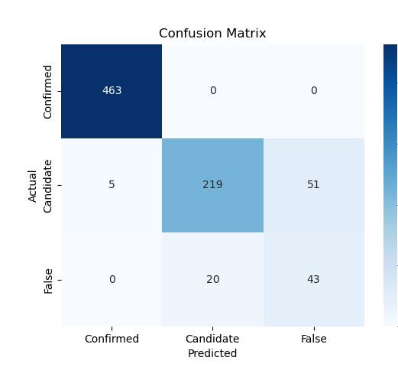
What did do?
Uses AI to classify potential exoplanets, highlighting the most promising candidates for further study.
Processes data faster and more accurately than traditional manual analysis.
Trained on NASA’s Kepler, K2, and TESS datasets.

Slide 4
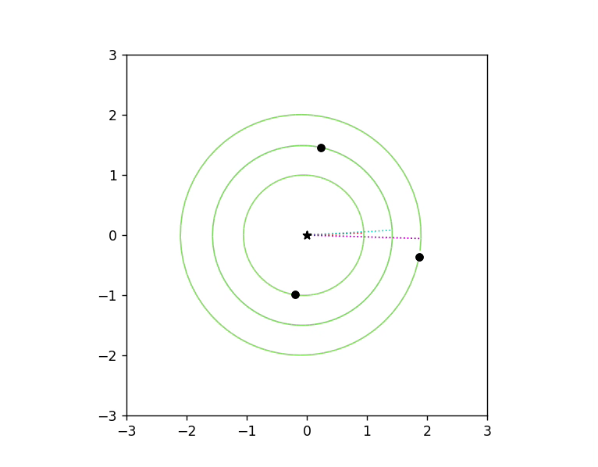
Orbit Simulation
Injects hypothetical planets into real systems based on NASA K1 and K2 data
Tests long-term orbital stability
Confirms physically and statistically viable planets

Slide 5
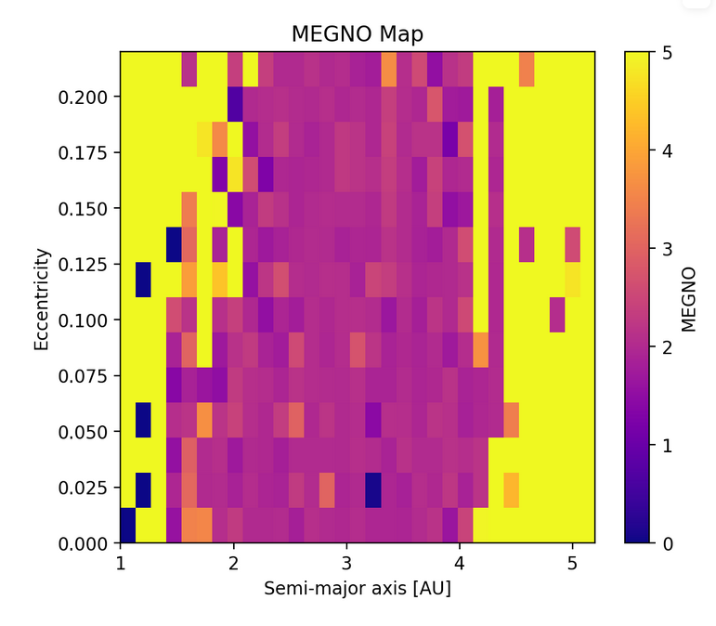
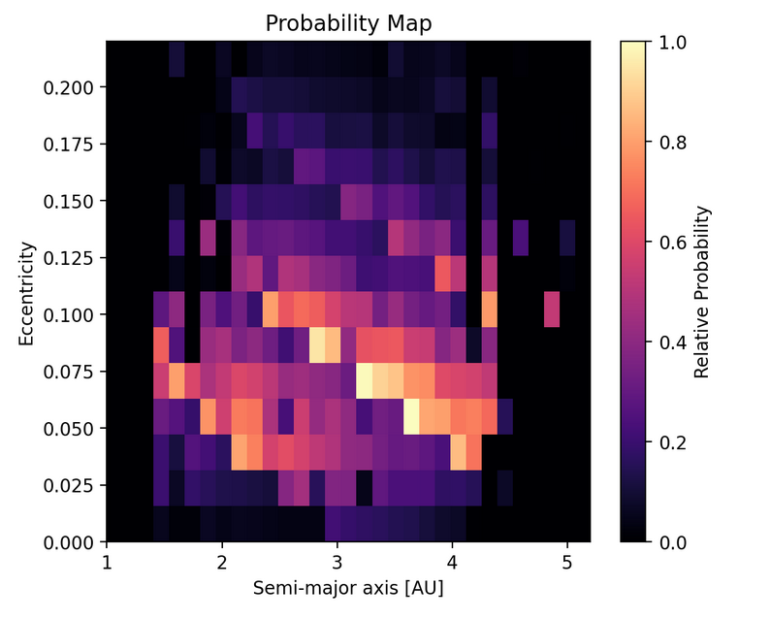
MEGNO - (Mean Exponential Growth factor of Nearby orbits)
MEGNO measures orbital stability of a theoretical exoplanet.
Darker areas = more stable.
Grid-based probability mapping shows where a planet is most likely to exist. ​
Lighter area = higher probability​

Slide 6
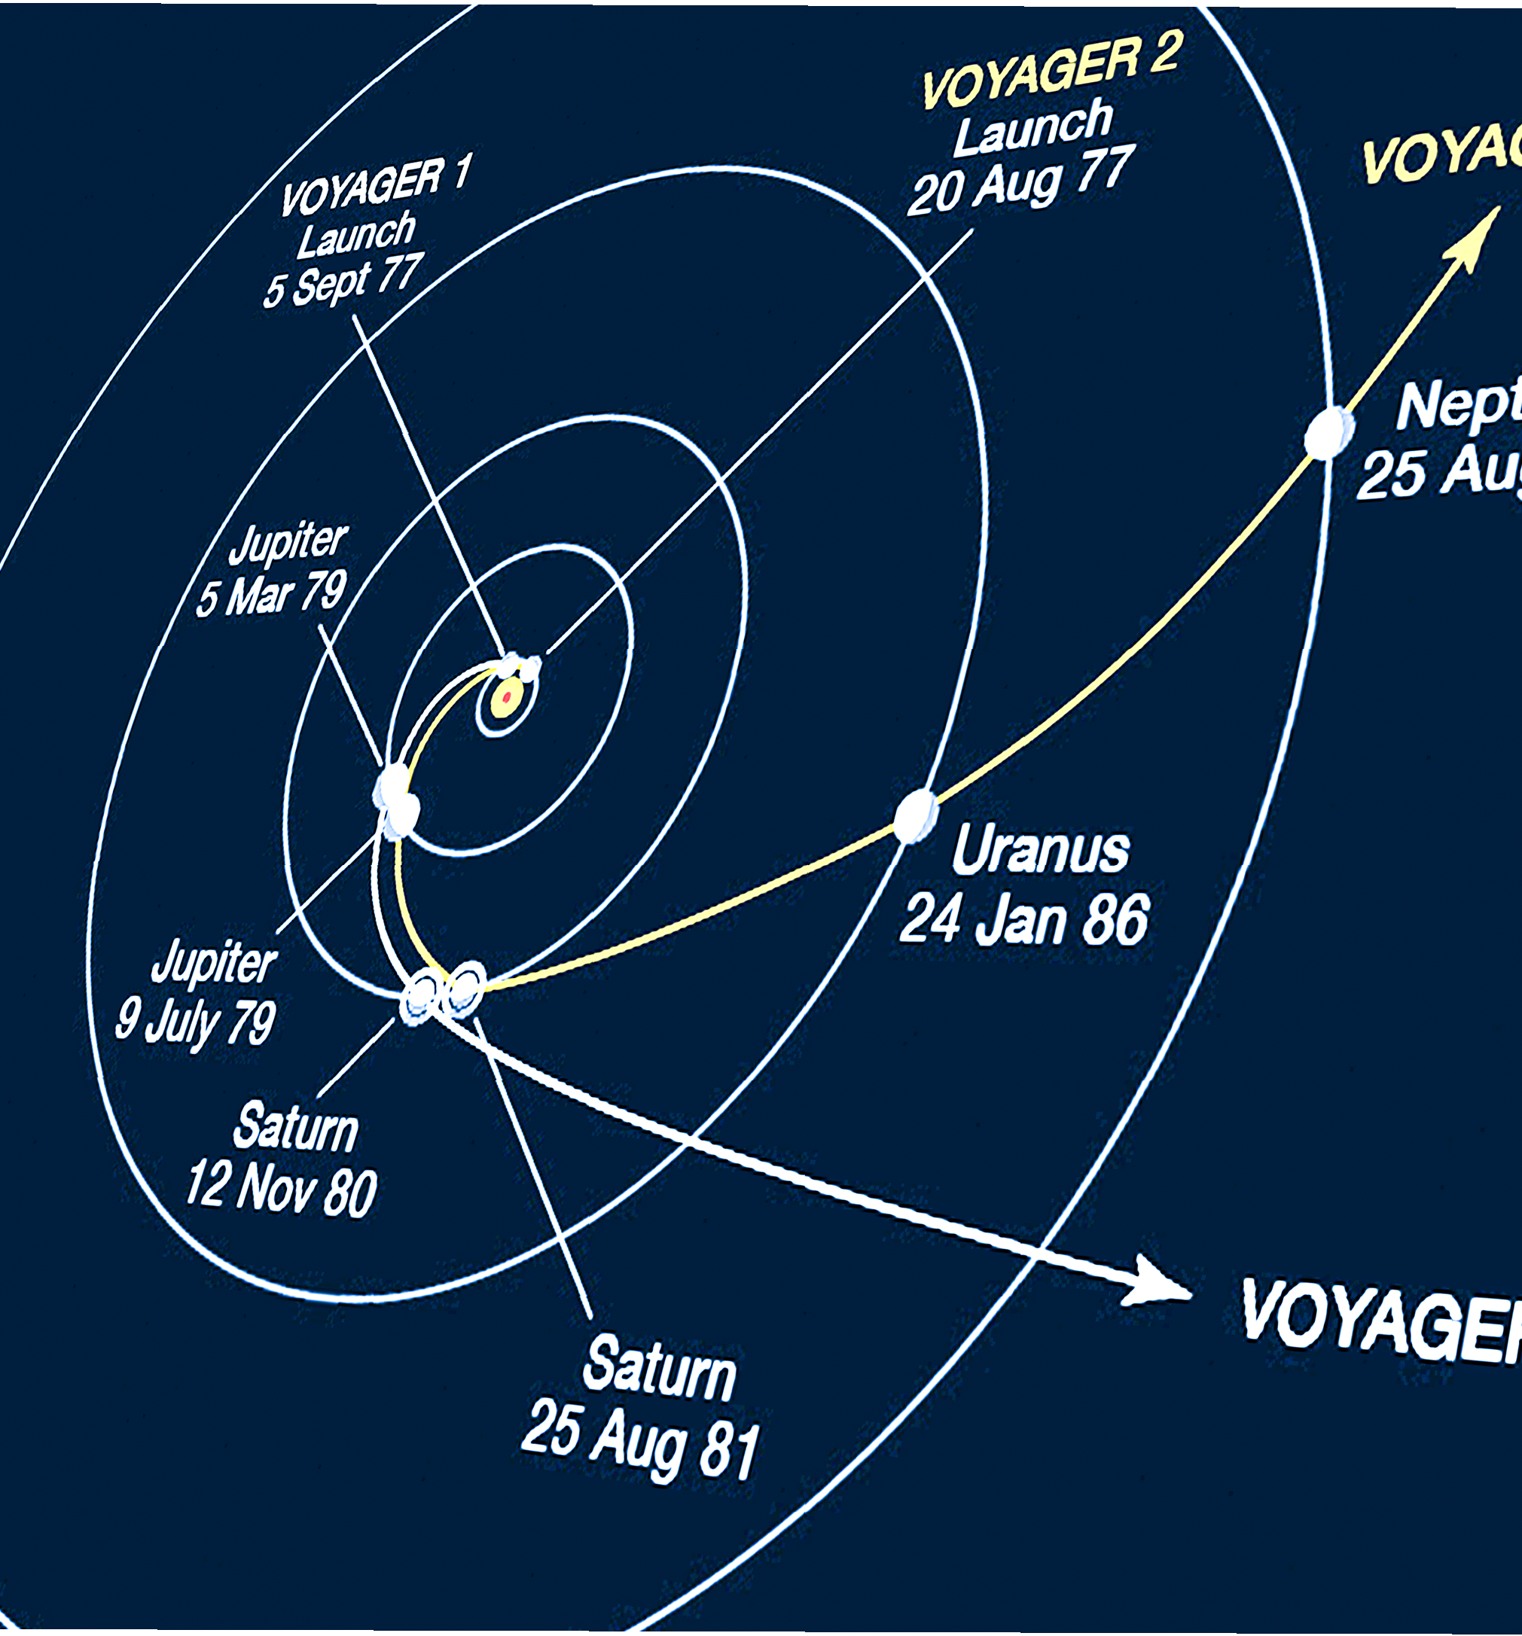
Conclusion and Future Work
Speeds up the identification of exoplanets.
Combines AI and orbital dynamics to find and validate, and predict location of exoplanets in stable regions of known systems.
In the future, we will Improves data processing for complex datasets, enhancing model accuracy for both the classification and physics models.

